Slide 2
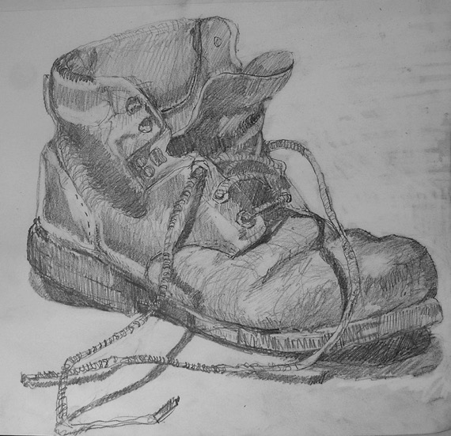
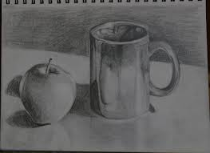
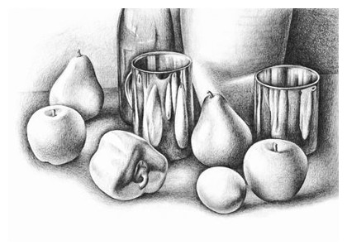
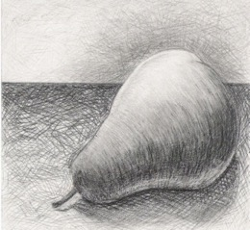
Task One
AO3
Produce: 1.
An A4 size line drawing. Fill a page. Add contour lines and details to enhance the study.
2.
An A4 size (full page) shaded study. Use a wide range of tones and details.
Draw any objects to be found in a room. You might use it later on as the project progresses.
Some examples: Ornaments, objects found in the kitchen, food, fruits/vegetables, flowers, plants, shoes, tool box, handbag, school bag, fabrics, technology etc…
Take photographs. Annotate your work.

Slide 3
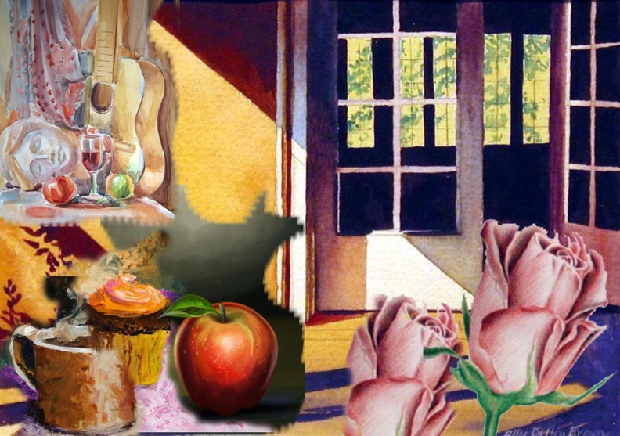
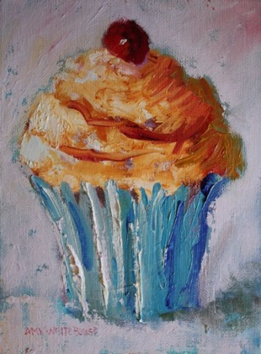
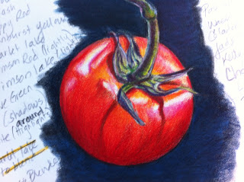
Task Two
AO3
Take photographs. Annotate your work.
Fill a page in your book with 2 sustained (well developed) colour studies.
Work from observation. Take photographs and add them to your book. You may work from your own photographs.

Slide 4
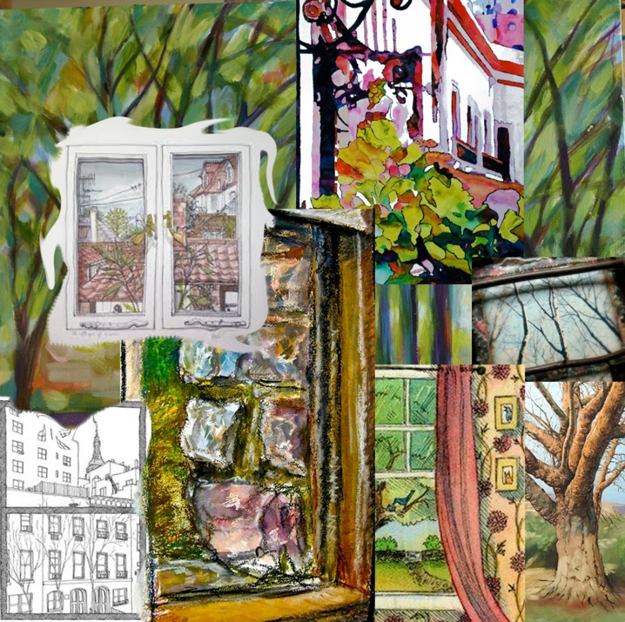
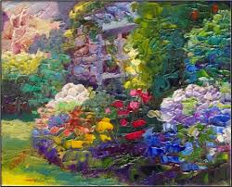
Task Three
AO2/3
Take photographs. Annotate your work.
Produce a sustained study of a view from a window.
Experiment with a range of media (i.e. paint, biro, collage, photo-montage etc…)
Take photographs (outside/ Inside the house).

Slide 5
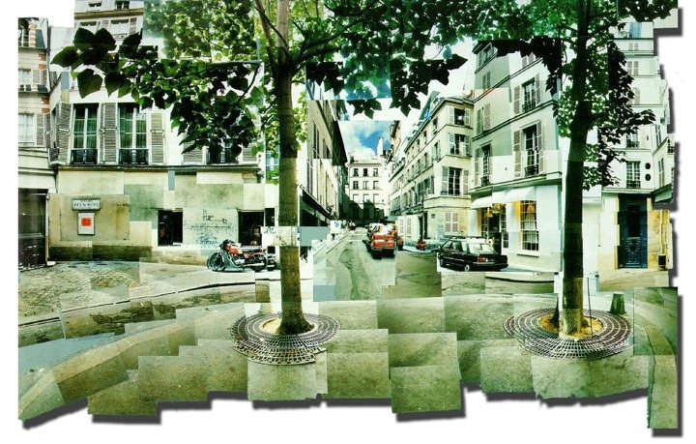

Slide 6
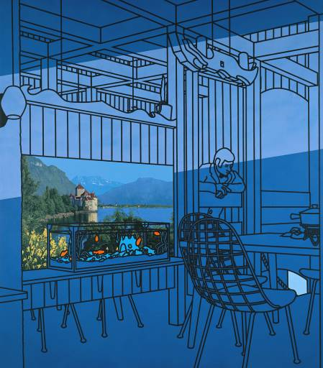

Slide 7
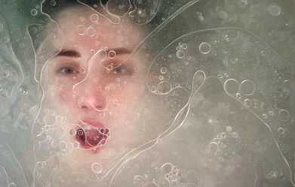
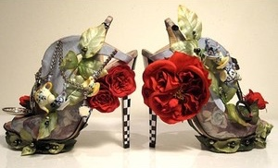
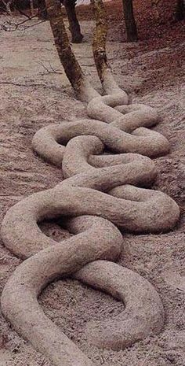
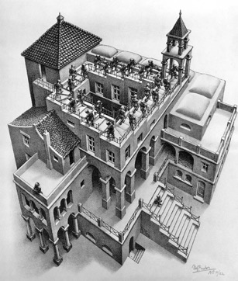
Task Four
AO1
Andrew Curtis
Nicholas Kirkwood
Look at the list of artists on the pages overleaf >>>
Choose 5 artists for inspiration. Think what could help you with your own work and how would you like to develop it. Write it as an introduction.
Add photographic examples of your chosen artists’ work.
Write the artists’ names and research some information about the chosen art work. Write about the ideas behind their work, techniques used, media applied etc… Explain your interest in the chosen work and how the artists’ work relates to the project theme.
Use a double page in your sketchbook
Paula Rego
Alyssa Monks
Andy Goldsworthy
M. C. Escher

Slide 8
A range of artists
Natural Forms and landscapes
Georgia O’keeffe
Bill Jacklin
Judice Reece (textile on canvas)
David Hockney
Jeff Wall- Photographer
Constable
Angie Lewin
Paul Cezanne
Sam Taylor Wood
Juan Sanchez Cotan
James Faiegreave
Peter doig
The Human
Mary Ellen Mark (photographer)
David Hockney (photomontage)
Francis Bacon (distortion)
Freda Kahlo
Lucian Freud
Chuck close
Max Beckmann
Imagination
Cornelia Parker (installation)
Robert Rauschenberg (mixed media)
Hannah Hoch
Mimmo Rotella (De Collage)
Henri Magritte (Surreal)
Kurt Schwitters (collage

Slide 9
Interior, exterior and townscape
John Bratby
Robert Delaunay
Phyllida Barlow (Installation)
Cyril Power
Jeff Wall (photographer).
Anish Kapoor (sculptor)
Anthony Green
Edward Hopper
Richard Estes
Giorgio de Chirico
Objects
Jann Haworth (3D)
Andreas Gursky
El Antatsui
Pablo Picasso
Jim Dine
John Wannacott
Audrey Flack
Martin Craig Martin
Arman (installation)
Claes Oldenburg (sculptor)

Slide 10
Surface Textures
Boyle Family
Van Gogh
Monet
Andy Goldsworthy (Land Art)
Julian Schnabel
Pierre Bonnard
Barbara Hepworth (sculptor)
Turner
Antonio Tapies (abstract)
Anslem Kiefer
Jiang Pengvi (installation)
Places
Grayson Perry
Andrew Wyeth
Ando Hiroshige
Atkinson Grimshaw
Andre Derain
Paul Nash
George Shaw

Slide 11
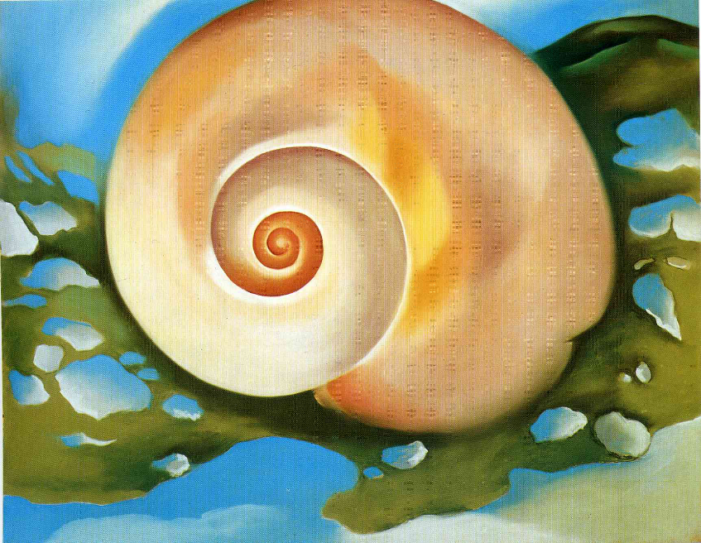
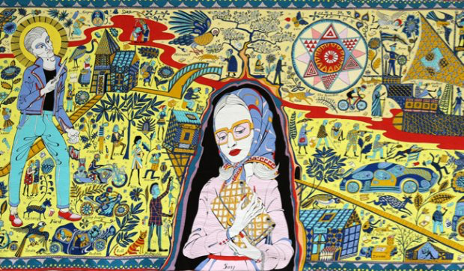
Task Five
AO1
Create a transcription of a piece of artwork created by one of the artists you researched for Task 4.
Decide the appropriate media to use for your transcription.
This study should fill one page
in your sketchbook.
Include a few sentences explaining
whose work you have transcribed
and why you chose that piece.
Print off a copy of the artwork you
have transcribed and stick this in your sketchbook as a reference.
You could transcribe a section rather than the whole piece.

Slide 12
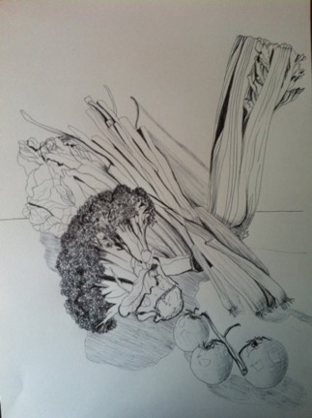
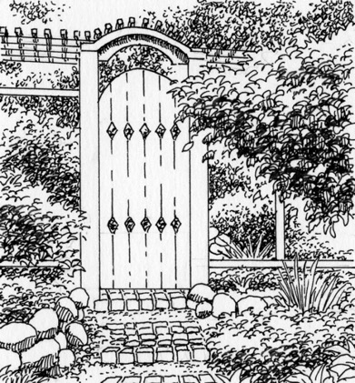
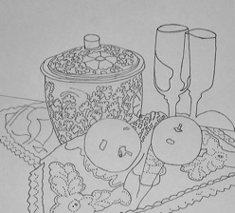
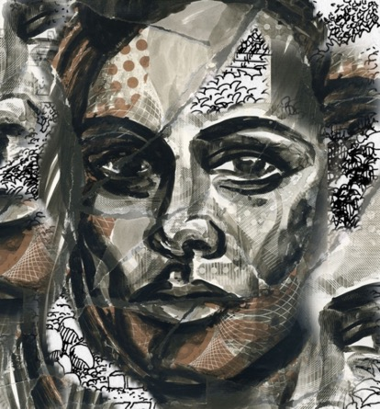
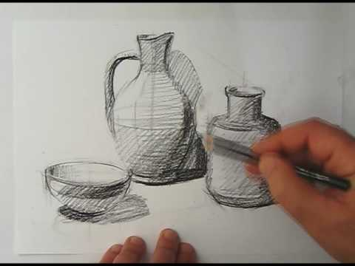
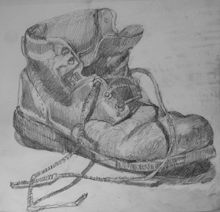
Task Six
AO3
Fill a page with 4 possible designs for the first final study. Work from observation, homework tasks and photographs.
Look at your class work and think about your best compositions.
Take more photographs of possible ideas.

Slide 13
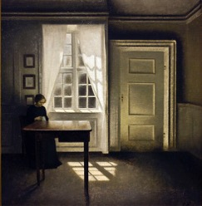
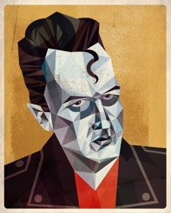
Task Seven
AO1
In-depth written study of your chosen artist, linking to your final design(2D or 3D).
Produce a written study on an artist who links and has connections with your ideas and final composition.
My chosen artist is:
Present your work with research and your own opinion.
Introduction.
Glue some examples of your chosen artist’s work. Explain you are looking at the artist to help you develop your own ideas further. What do you like about your chosen artist’s work?
Section one.
Brief biography of your chosen artist’s life.
Section two.
Describe the type of work the artist does. Explain his/her ideas behind the work. Explain any art movements the artist belonged to.
Section three.
Describe the methods, media and techniques the artist used.
Section four.
Describe how the artist work and ideas link to your own ideas and work.
Use a double page in your sketchbook
Look at the lists of artists on the pages overleaf for help with this task.

Slide 14
A range of artists
Natural Forms and landscapes
Georgia O’keeffe
Bill Jacklin
Judice Reece (textile on canvas)
David Hockney
Jeff Wall- Photographer
Constable
Angie Lewin
Paul Cezanne
Sam Taylor Wood
Juan Sanchez Cotan
James Faiegreave
Peter doig
The Human
Mary Ellen Mark (photographer)
David Hockney (photomontage)
Francis Bacon (distortion)
Freda Kahlo
Lucian Freud
Chuck close
Max Beckmann
Imagination
Cornelia Parker (installation)
Robert Rauschenberg (mixed media)
Hannah Hoch
Mimmo Rotella (De Collage)
Henri Magritte (Surreal)
Kurt Schwitters (collage

Slide 15
Interior, exterior and townscape
John Bratby
Robert Delaunay
Phyllida Barlow (Installation)
Cyril Power
Jeff Wall (photographer).
Anish Kapoor (sculptor)
Anthony Green
Edward Hopper
Richard Estes
Giorgio de Chirico
Objects
Jann Haworth (3D)
Andreas Gursky
El Antatsui
Pablo Picasso
Jim Dine
John Wannacott
Audrey Flack
Martin Craig Martin
Arman (installation)
Claes Oldenburg (sculptor)

Slide 16
Surface Textures
Boyle Family
Van Gogh
Monet
Andy Goldsworthy (Land Art)
Julian Schnabel
Pierre Bonnard
Barbara Hepworth (sculptor)
Turner
Antonio Tapies (abstract)
Anslem Kiefer
Jiang Pengvi (installation)
Places
Grayson Perry
Andrew Wyeth
Ando Hiroshige
Atkinson Grimshaw
Andre Derain
Paul Nash
George Shaw

Slide 17
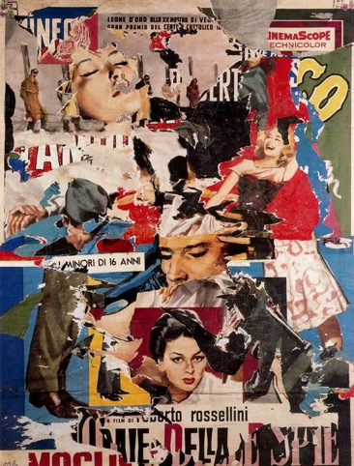
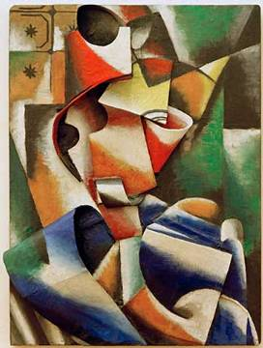
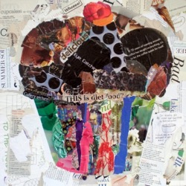
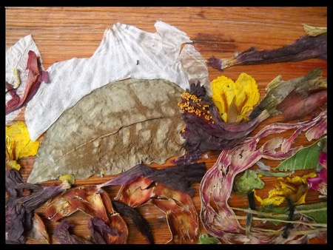
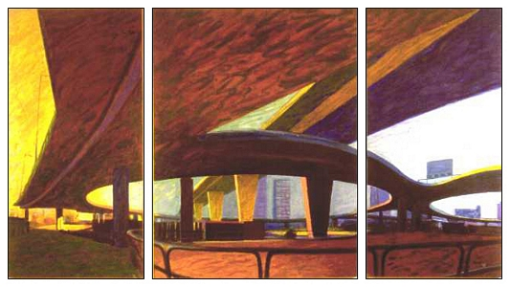
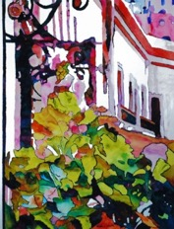
Task Eight
AO2
Enlarge your best compositional design to A4 size. Experiment with a range of media / techniques (paint, collage, expressive colours etc…). If you intend to work in 3D…create a small maquette / model.

Slide 18
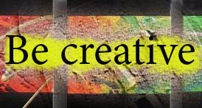
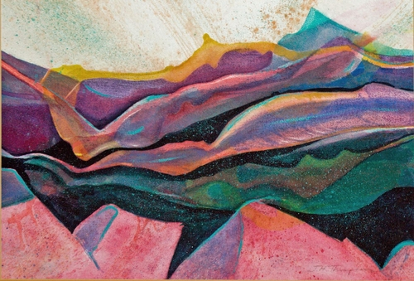
Task Nine
AO4
Complete your final design started in class. Use the media you intend to use on your larger class final.
Take photographs. Annotate your work.

