Slide 1
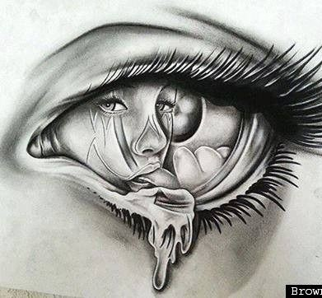
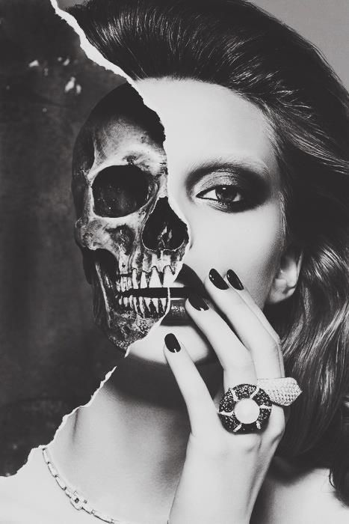
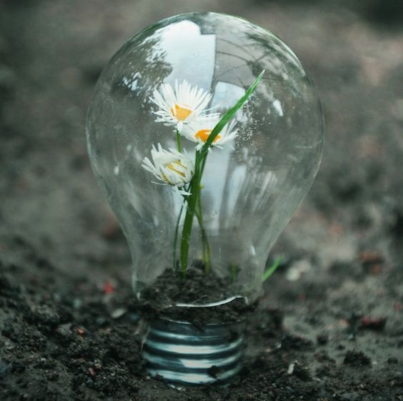
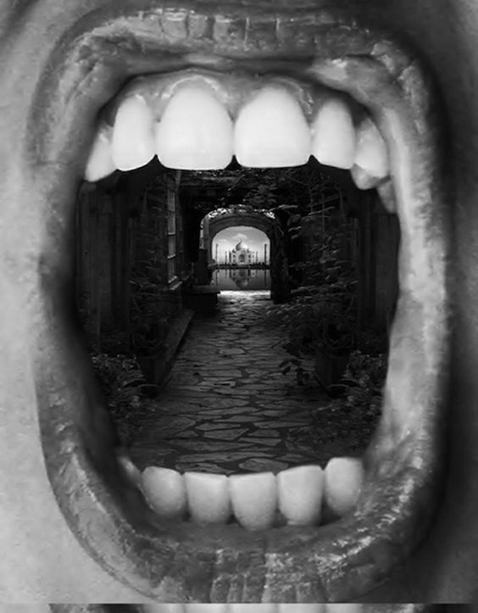
Year 10 Art Exam
Inside/Outside: Homework

Slide 2
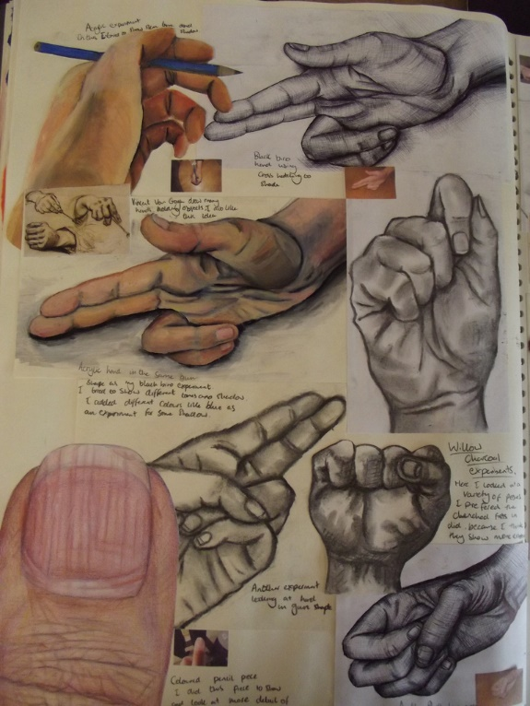
Task One
What next?
Look at your work so far. (Final pieces and/or book work)
Think about the content of your work (for example, what is your subject matter? Objects, Nature, Faces, Figures etc…
Have you been working in 2D or 3D and what materials have you used?
Produce 4 line designs on A4 paper of possible exam pieces…(teacher led demo). Link the ideas to your previous work.
DIVIDE A4 PAGE INTO 4 SECTIONS.
DRAW 4 DETAILED LINE DESIGNS LINKED TO YOUR PREVIOUS WORK

Slide 3
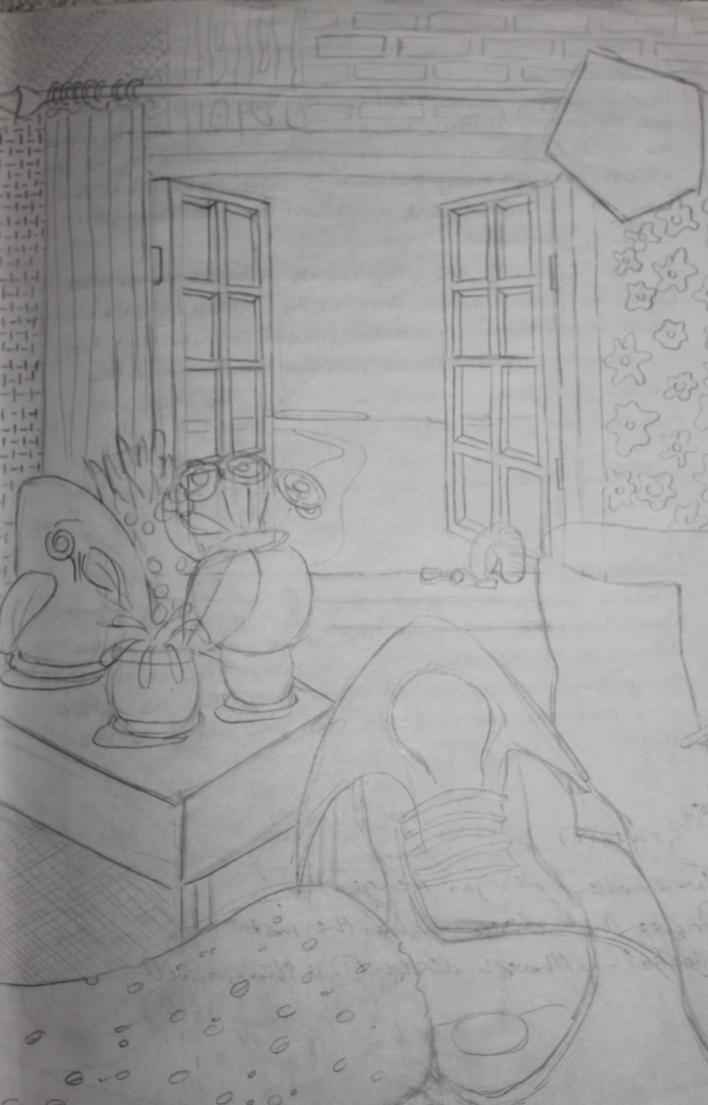
Task One continued
Look at the 4 ideas produced for task one.
Select the best final idea and enlarge it onto a new A4 page in your Art book.
Add more fine details to this study.
Annotate the idea describing media/materials you may use and if the idea is 2D / 3D.

Slide 4
Task Two
Complete an A4 refined final exam practice study.
Or
complete a refined 3D model of your exam piece.
Use the media/materials you intend to work with in the exam.

Slide 5
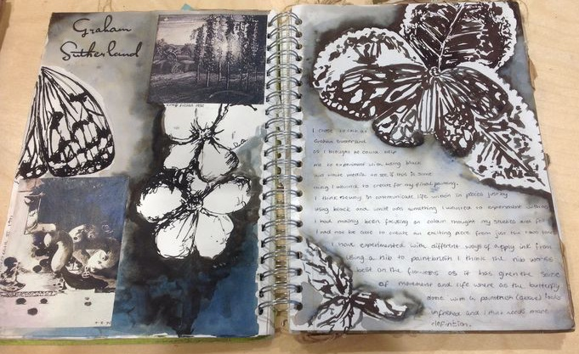
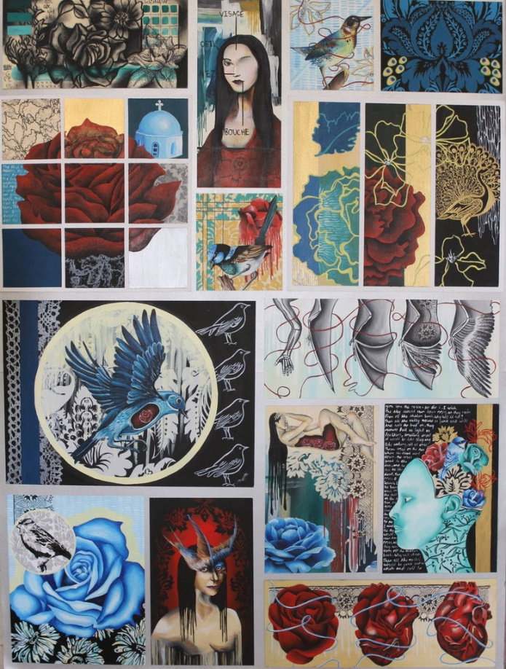
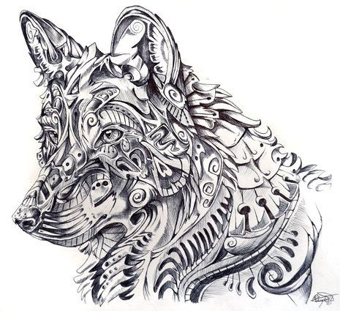
Get ready for the exam
Complete all your exam homework tasks.
Complete any previous tasks from earlier in the project.
Glue any photos / resources
you need for the exam into
your book.
ARE YOU READY FOR YOUR EXAM?

